Slide 1

P peline
The Data
Byte 2
© Jennifer Mankoff
The Data Pipeline; HCII; Spring 2014

Slide 2
Introducing Byte 2
jmankoff-byte2.appspot.com
Use data from Google Fusion Tables (& SQL)
Use a key to access an API
Using CSV and JSON
Read and write from files
Conducting exploratory data analysis

Slide 3
Data Set
http://portal.louisvilleky.gov/dataset/animal-services-outcomes-data
Or
https://www.google.com/fusiontables/DataSource?docid=1xXFu8T2xycJprygAzGjhIjhMt9dKY-1Nacq2SjQ#rows:id=1
Lots can be done just with this…

Slide 4
Debugging in Google AppSpot
logger.info()
Understand the flow of information
Working in pure python to test your assumptions

Slide 5
Getting the Data
Manually Register for Key
Need an API Key (instructions on website)
Then use a library to build the URL and post a request
service = build('fusiontables', 'v1', developerKey=API_KEY)
Construct a URL
Post it to the Server
Collect the Response (often XML or JSON)
Parse and Act

Slide 6
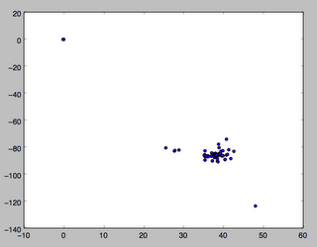
Exploratory Analysis
Combination of statistics and graphics
Use of PyPlot

